Slide 1
Predicting SAT Scores in New York City
Lorena Dominquez Ponce & Karoline Skatteboe
Advanced Analytics Edge 15.071

Slide 2
What factors influence SAT scores in NYC High Schools?

Slide 3

Why are SAT scores important
High School graduation reduced the chance of having health problems, engage in criminal activity, and require public assistance
SAT is required to attend higher education in the US
A post high school education lead to higher salaries, higher job satisfaction, making better decisions, a more stable job situation
SAT can serve as a proxy of school quality
Students from high quality high schools have an easier transition and perform better at higher level institutions
SAT is taken by high school juniors/seniors and consists of 3 sections, verbal, math, and writing. Total score is out of 2400, each section out of 800

Slide 4
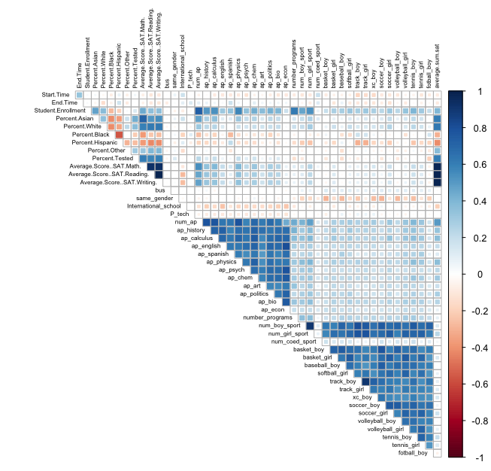
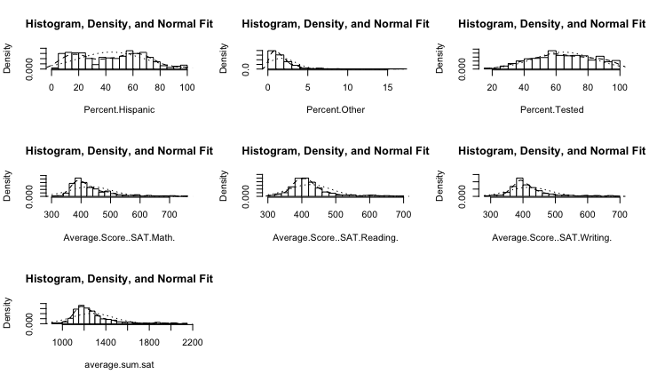
Data
The data is collected from New York Department of Education and The College Board
Created additional binary and numerical regarding demographic variables and school offering, languages, extra curricular, AP, sports
The dependent variable is SAT Score

Slide 5
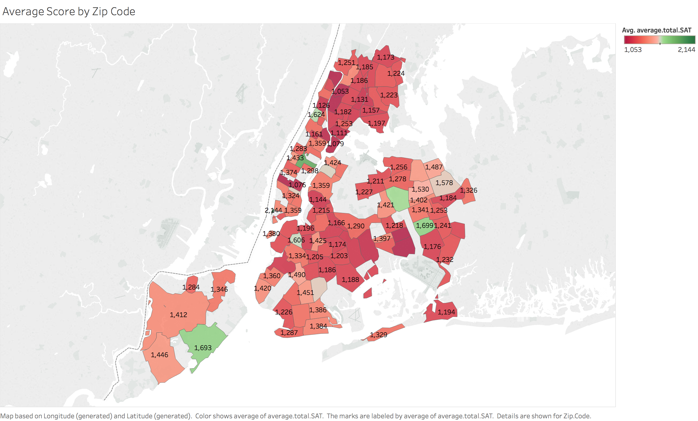
Zip Code and Total Score

Slide 6
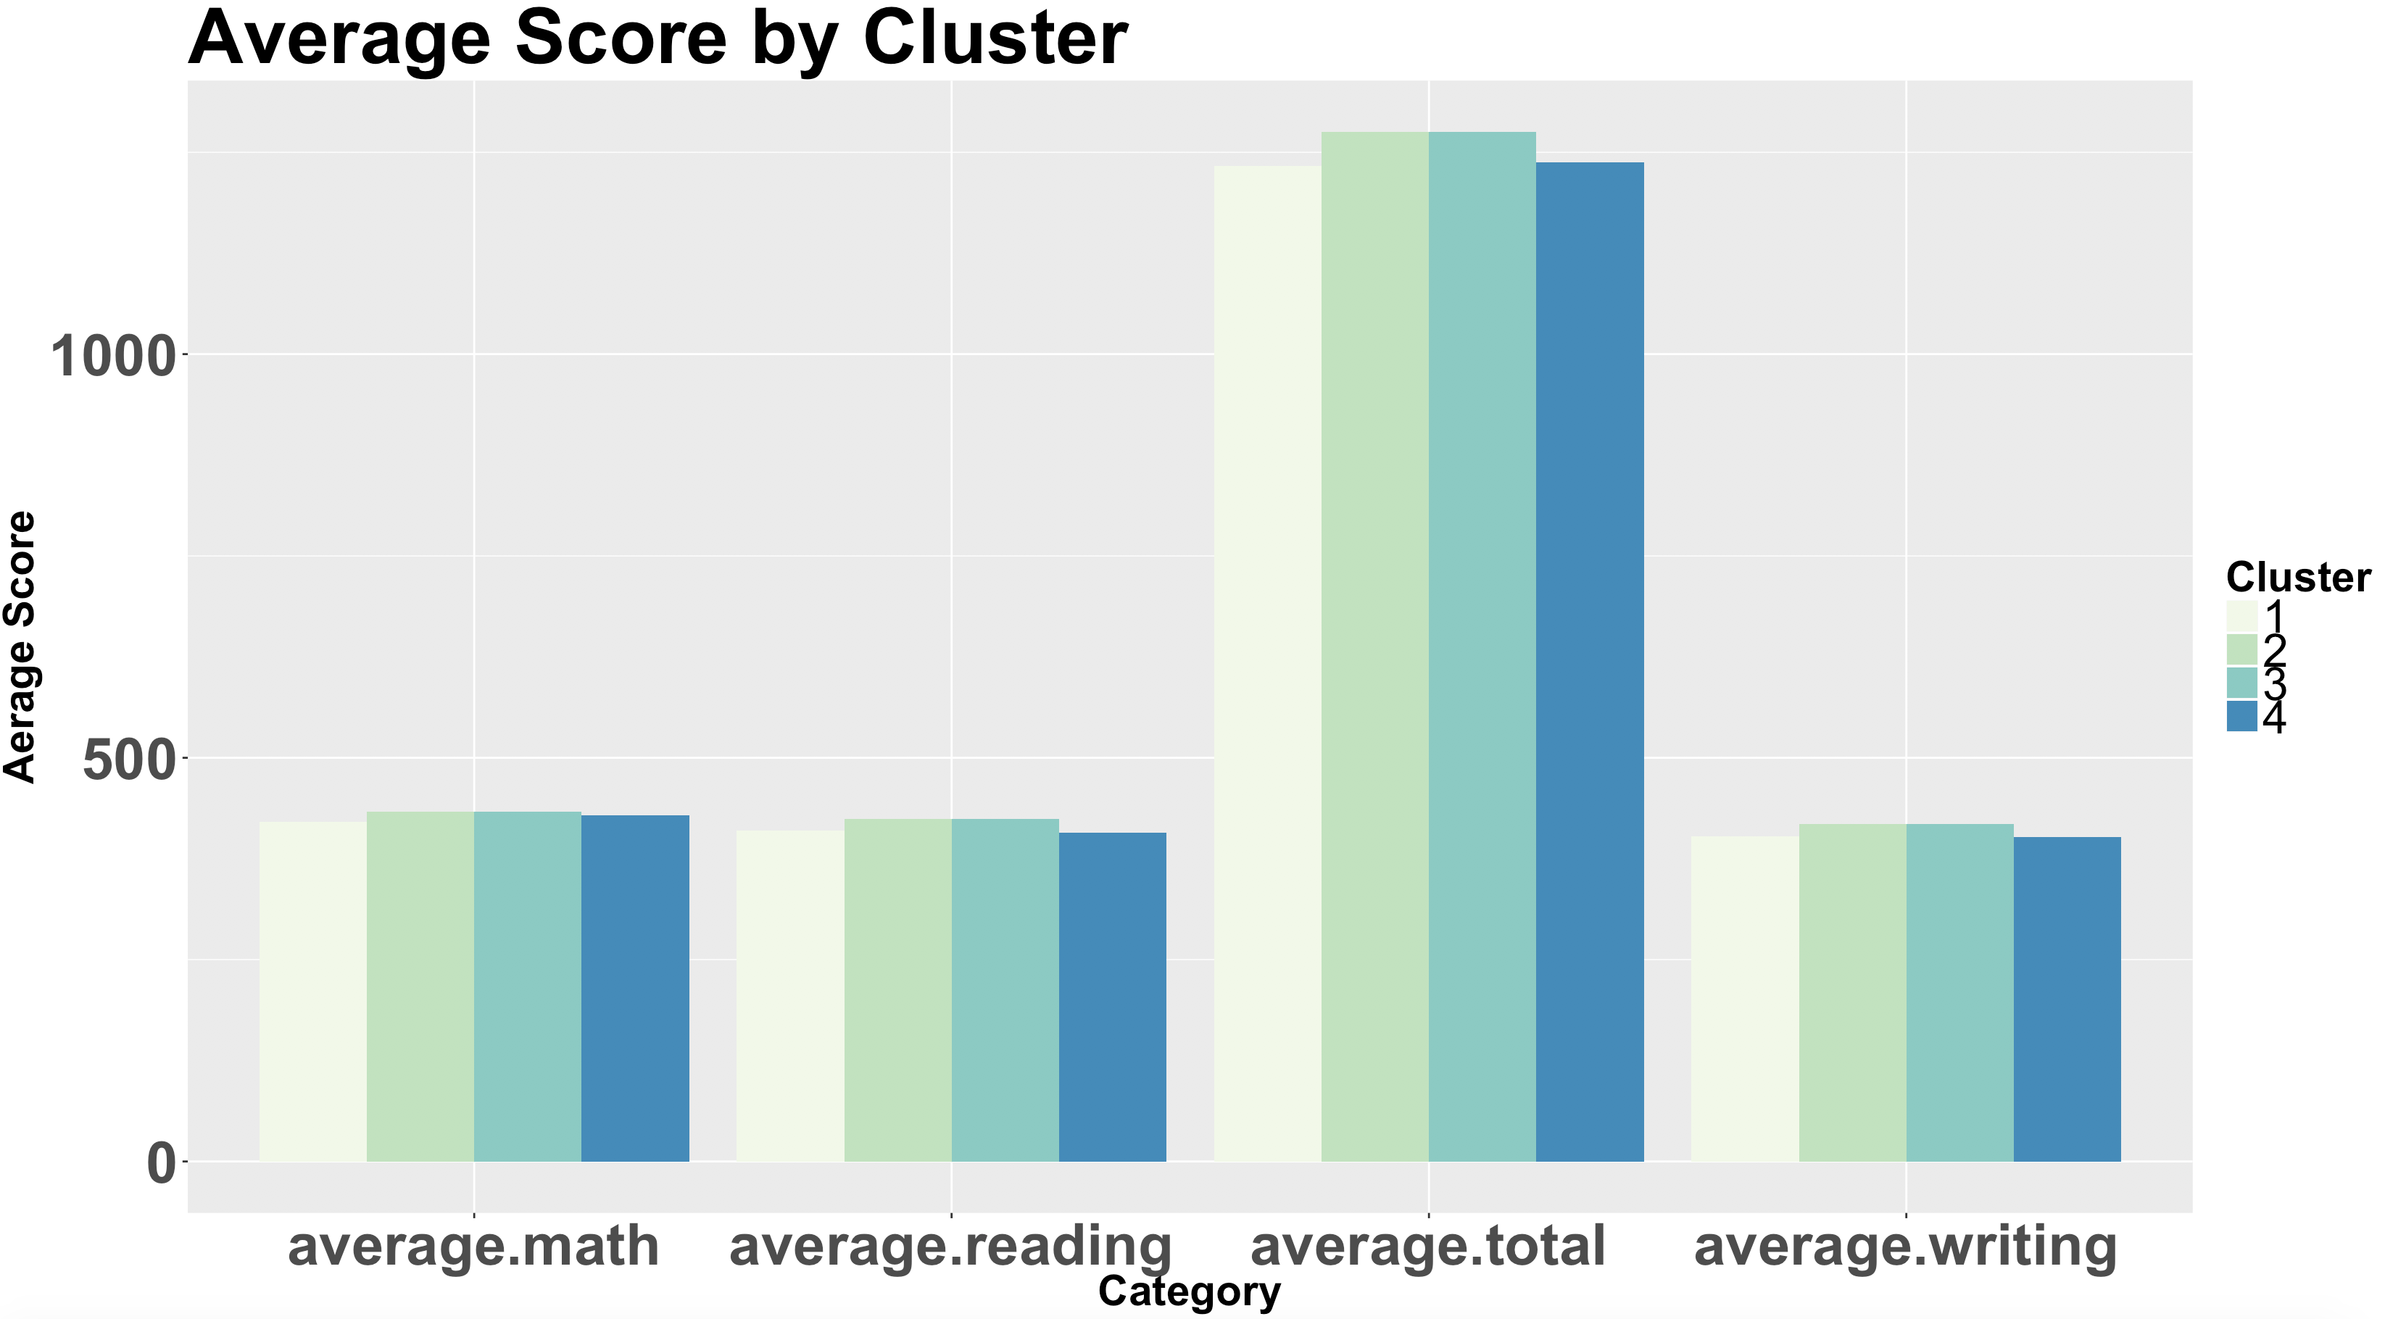
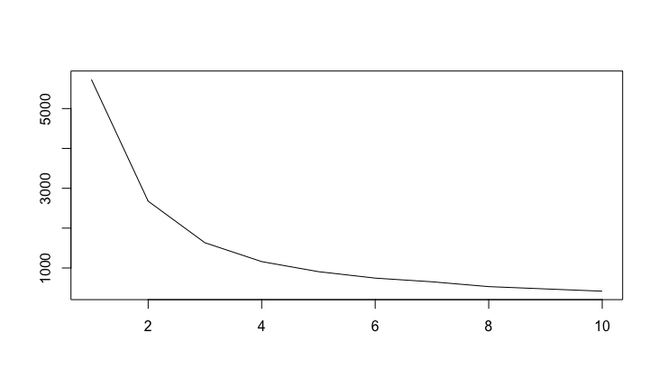
Cluster Analysis Using 4 Clusters
 | 1 | 2 | 3 | 4
# Entries in Cluster | 27 | 98 | 92 | 7

Slide 7
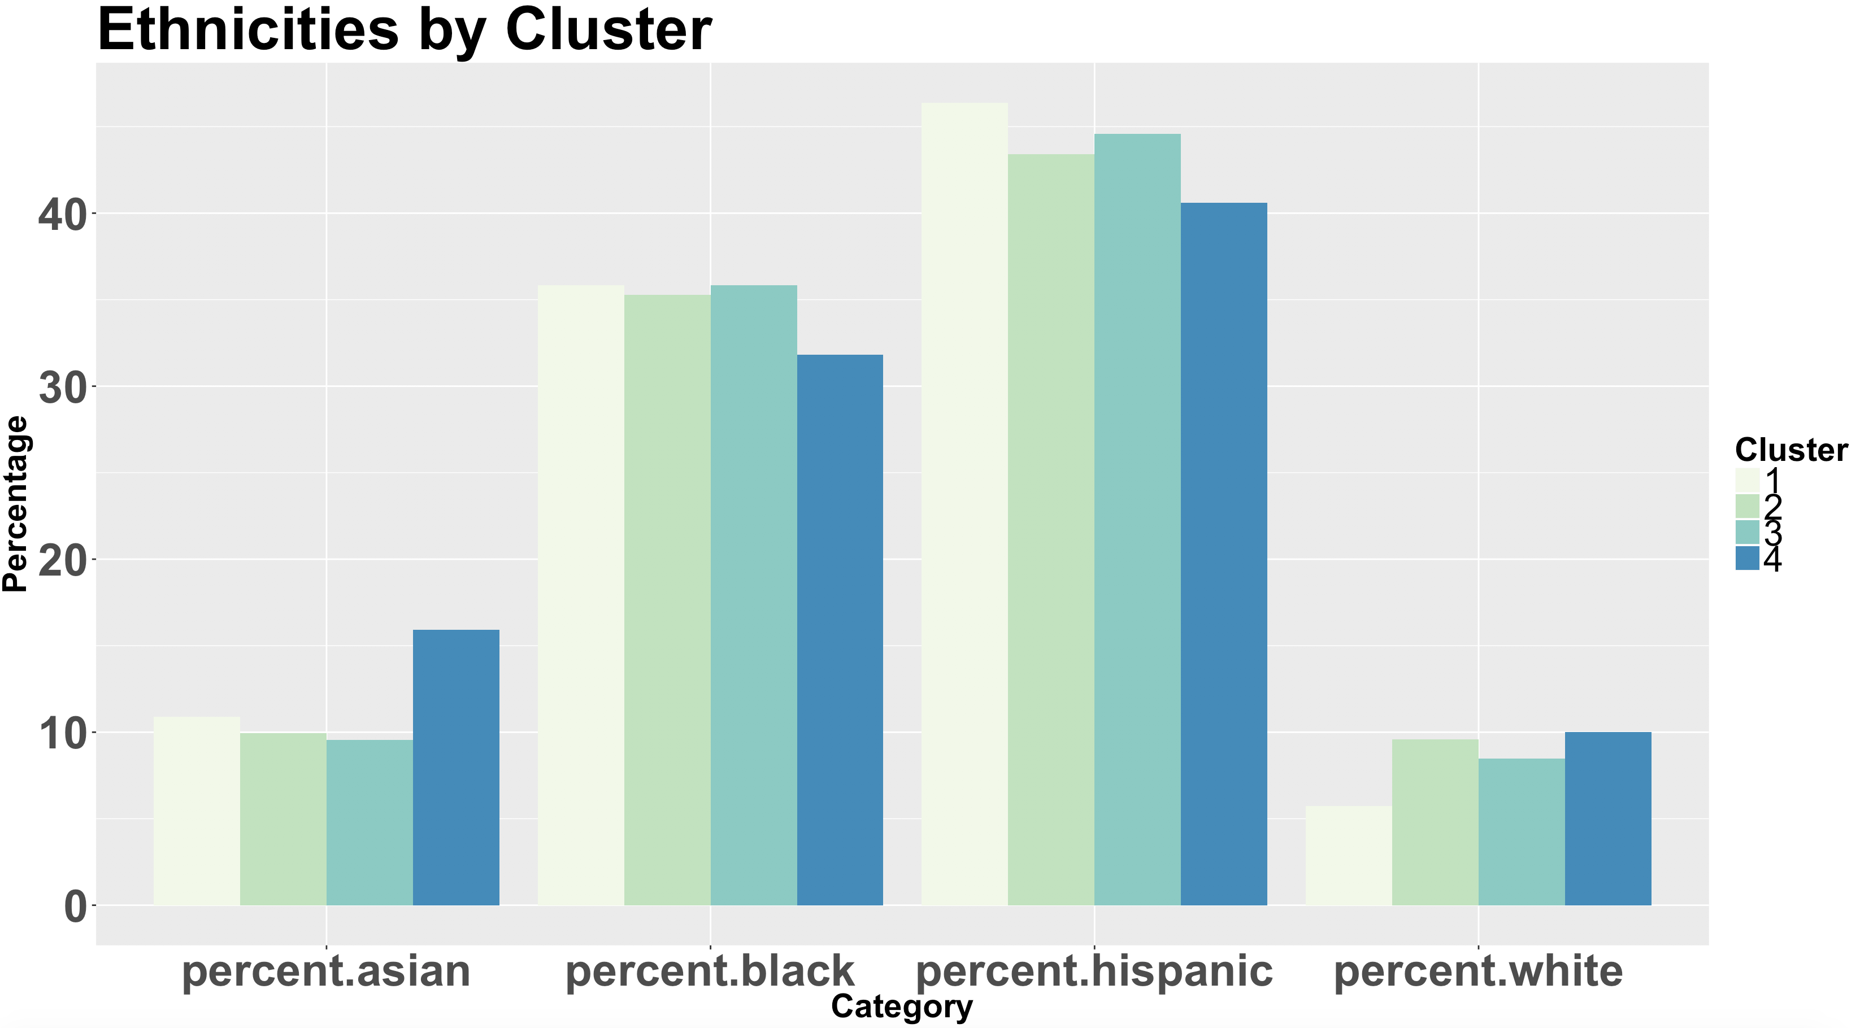
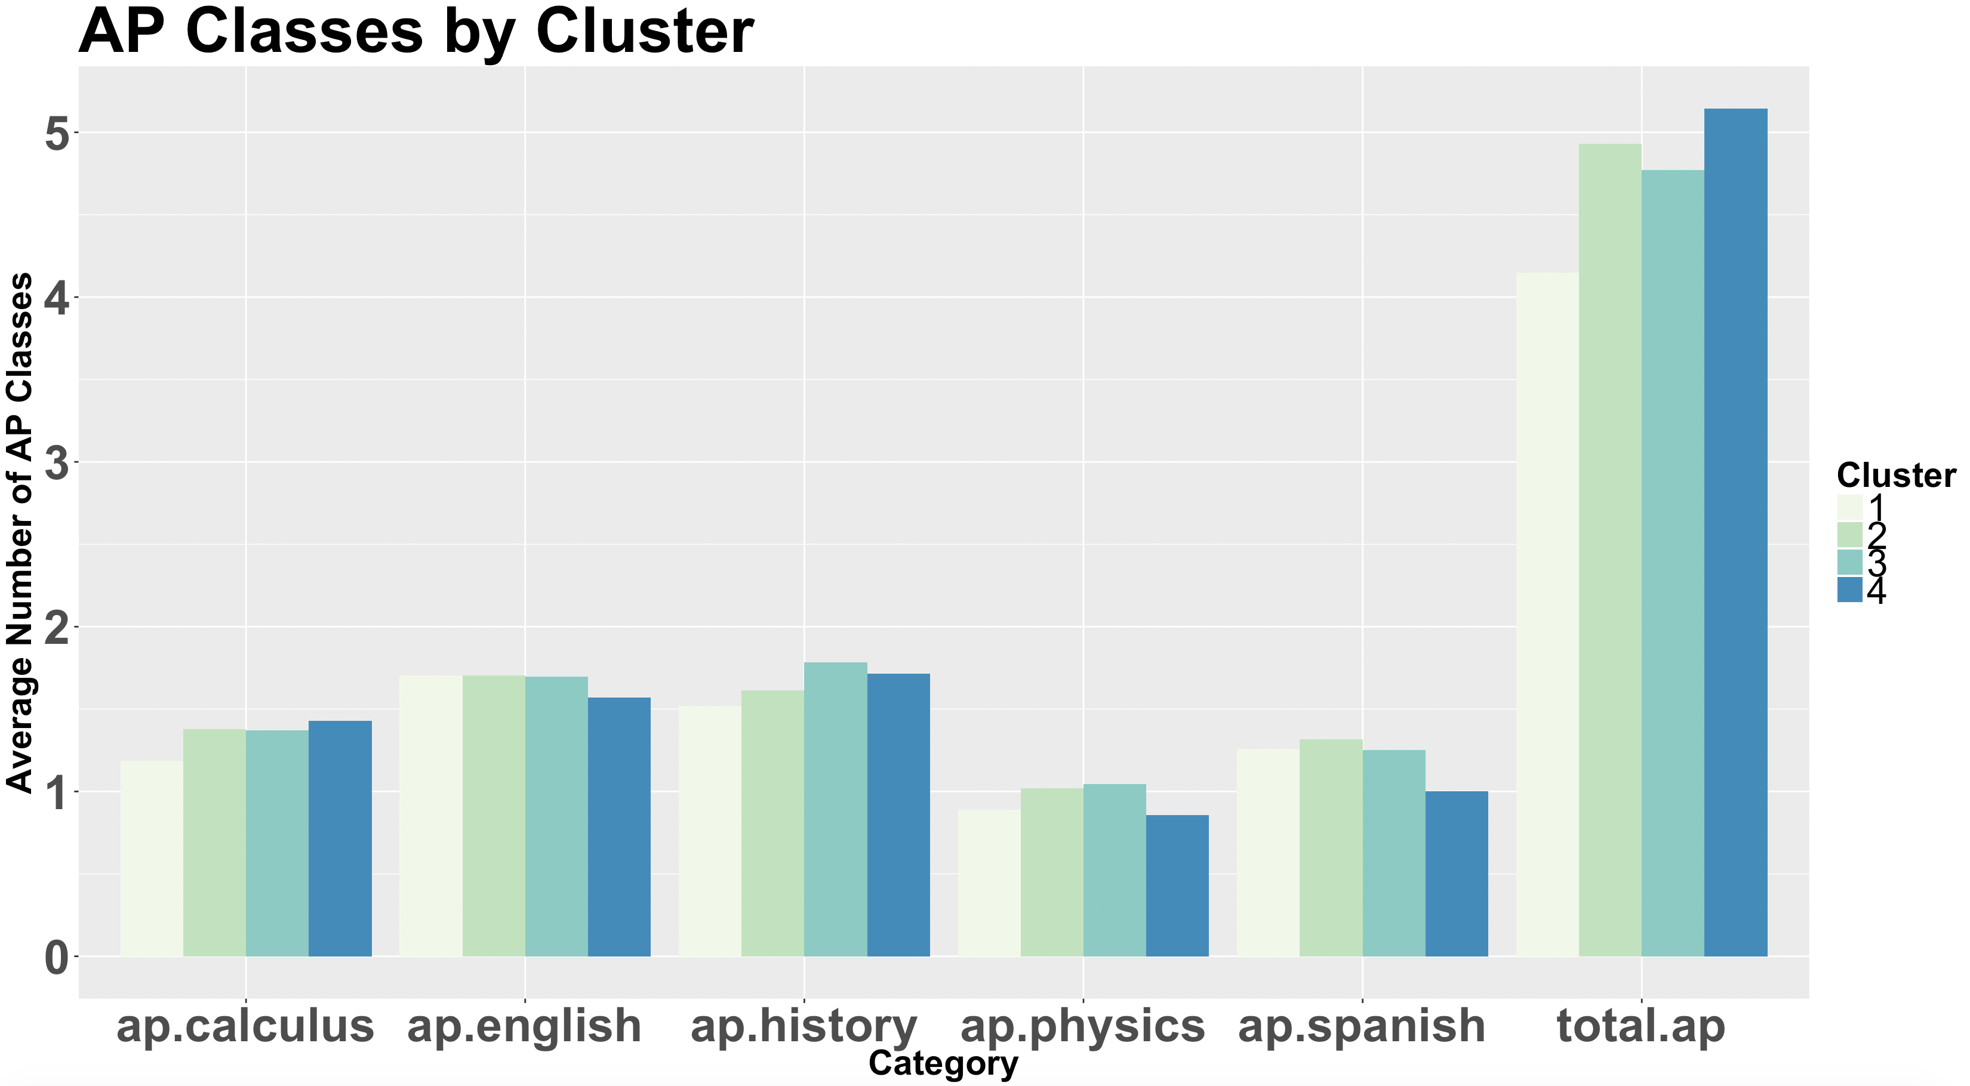
Etnicity Influence AP Class Offerings

Slide 8
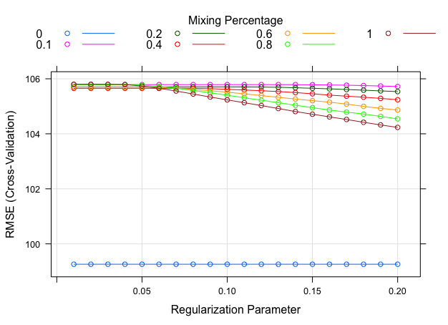
Regression
Variable Name | Coefficent
International School | -221.80224488
Specialized School | 216.14276419
Bus | 63.06359210
Soccer Men | 52.03991008
Bowling Girls | -60.4405832
Spanish | 53.06292294

Slide 9
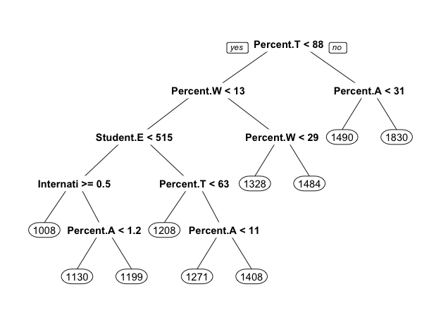
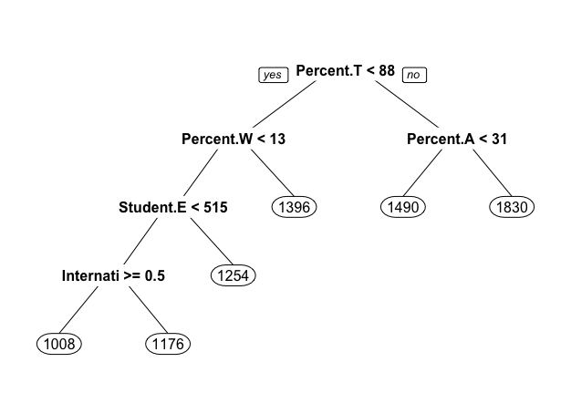
Decision Tree

Slide 10
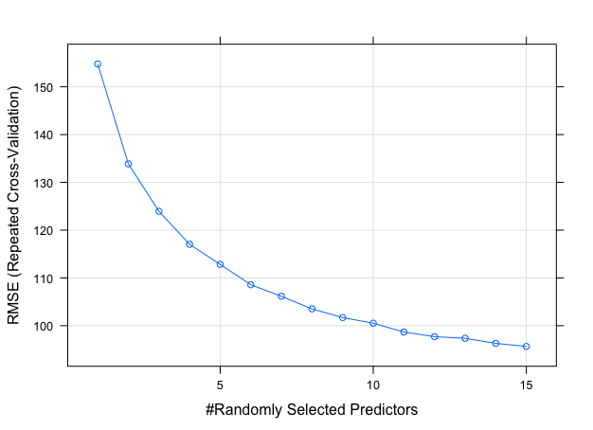
Random Forrest

Slide 11
Summary
Model | Train RMSE | Train R² | Validation RMSE | Train R²
Regression
Decision Tree
Random Forrest

Slide 12
Actions

Slide 13

QUESTIONS?
Thank you!

